Slide 1

NETFLIX DATA ANALYSIS WITH PYTHON
Presenters:
Miss. Tahseen Begum_2010030168
Miss. Keerthana Pulugam_2010030445
Miss. Pravallika_201003004
Miss. Sowgna_2010030344
Guide: Chanda Raj Kumar Rao

Slide 2
Introduction
Netflix is one of the largest providers of online streaming services. It collects a huge amount of data because it has a very large subscriber base. In this article, I’m going to introduce you to a data science project on Netflix data analysis with Python.
We can analyze a lot of data and models from Netflix because this platform has consistently focused on changing business needs by shifting its business model from on-demand DVD movie rental and now focusing a lot about the production of their original shows.

Slide 3
Problem Statement
I’ll take a look at some very important models of Netflix data to understand what’s best for their business. Some of the most important tasks that we can analyze from Netflix data are:
Understand what content is available
Understand the similarities between the content
Understand the network between actors and directors
What exactly Netflix is focusing on
Sentiment analysis of content available on Netflix.

Slide 4
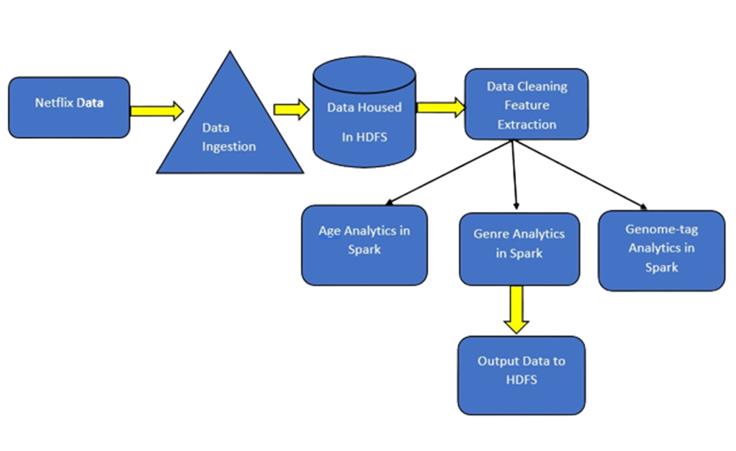
Flowchart

Slide 5
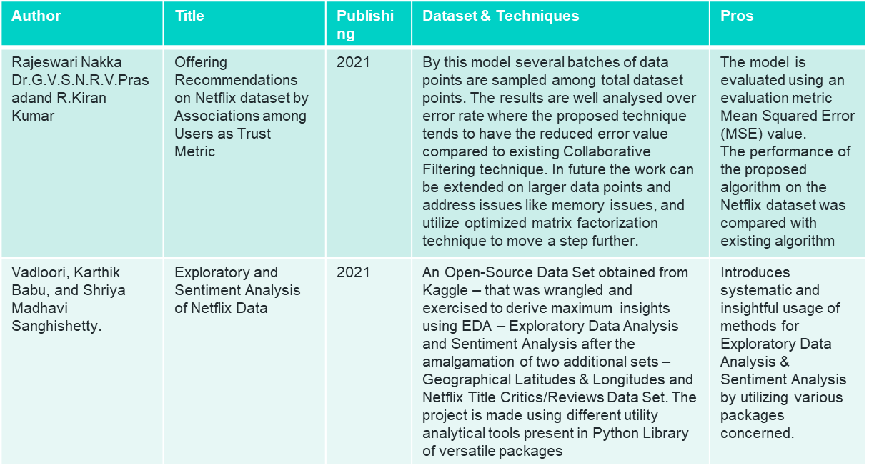
Literature Survey

Slide 6
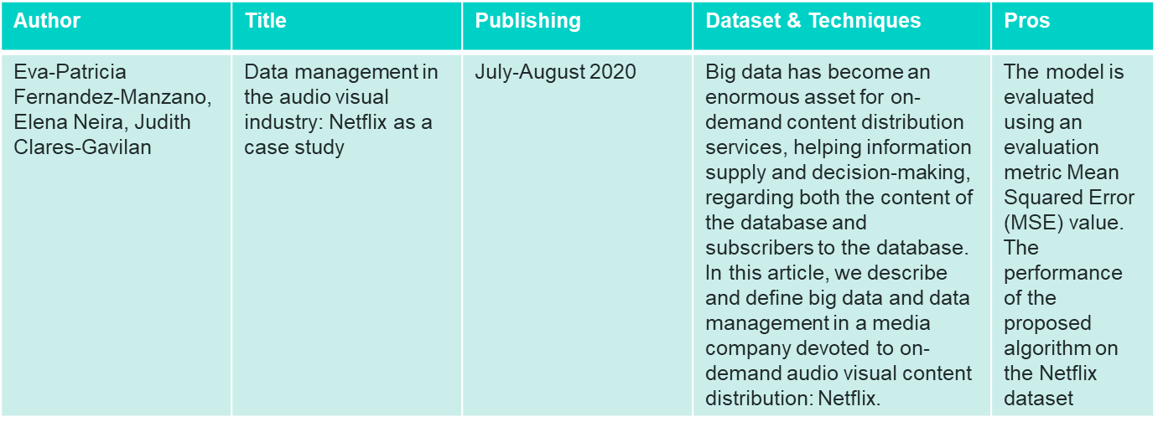

Slide 7
PROPOSED SYSTEM
Director
Category
Type: Movie and TV Shows
Rating
Relation between Type and Rating
Word Cloud
Country
Cast
• Importing Libraries
• Loading the dataset
• Data Cleaning:
• Deleting redundant columns.
• Dropping duplicates.
• Cleaning individual columns.
• Remove the NaN values from the dataset
• Some Transformations
• Data Visualization: Using plots to find relations between the features.

Slide 8
IMPLEMENTATION
Step-1:
!pip install matplotlib
Step-2:
#importing the dataset
import numpy as np # linear algebra
import pandas as pd # data processing, CSV file I/O (e.g. pd.read_csv)
import matplotlib.pyplot as plt
Step-3:
#to import csv file
netflix_data = pd.read_csv(r"C:\Users\Sowgn\OneDrive\Desktop\pfsd\netflix_titles.csv")
Step-4:
netflix_data
Step-5:
#head function
#to show top-5 records of the dataset
netflix_data.head()
Step-6:
#tail function
#to show bottom-5 records of dataset
netflix_data.tail()
Step-7:
#shape
#to show no of rows and colums
netflix_data.shape
Step-8:
#size
#to show no of total values(elements) in the dataset
netflix_data.size
Step-9:
netflix_data.columns
Step-10:
netflix_data.dtypes

Slide 9
IMPLEMENTATION
Step-11:
netflix_data.info()
Step-12:
netflix_data.value_counts()
Step-13:
netflix_data.nunique()
Step-14:
netflix_data[netflix_data.duplicated()]
Step-15:
netflix_data.drop_duplicates()
Step-16:
netflix_data.isnull()
Step-17:
netflix_data.isnull().sum()
Step-18:
!pip install seaborn
Step-19:
import seaborn as sns
Step-20:
sns.heatmap(netflix_data.isnull())
Step-21:
netflix_data[netflix_data['title'].isin(['Blood & Water’])]
Step-22:
netflix_data['Date_N']=pd.to_datetime(netflix_data['date_added’])
Step-23:
netflix_data.head()
Step-24:
netflix_data['Date_N'].dt.year.value_counts()
Step-25:
netflix_data['Date_N'].dt.year.value_counts().plot(kind='bar’)
Step-26:
netflix_data.groupby('type').type.count()

Slide 10
IMPLEMENTATION
<!DOCTYPE html>
<html>
<head>
<meta name="viewport" content="with=device-width, initial-scale=1.0">
<title>Netflix Data Analysis</title>
<link rel ="stylesheet" href="style.css">
<link rel="preconnect" href="https://fonts.googleapis.com">
<link rel="preconnect" href="https://fonts.gstatic.com" crossorigin>
<link href="https://fonts.googleapis.com/css2?family=Poppins:wght@100;200;300;400;600;700&display=swap" rel="stylesheet">
<link rel="stylesheet" href="https://stackpath.bootstrapcdn.com/font-awesome/4.7.0/css/font-awesome.min.css">
</head>
<body>
<section class="sub-header">
<nav

Slide 11
IMPLEMENTATION
<i class="fa fa-times-circle" onclick="hideMenu()"></i>
<ul>
<li><a href="index.html">HOME</a></li>
<li><a href="about.html">ABOUT</a></li>
<li><a href="movie.html">MOIVES</a></li>
<li><a href="data_analysis.html">ANALYSIS</a></li>
<li><a href="https://github.com/K-L-U-H/Netflix_Data_Analysis/blob/main/pfsd%20data%20preprocessing%20(1).ipynb">DATA ANALYSIS</a></li>
<li><a href="https://github.com/K-L-U-H/Netflix_Data_Analysis">PROJECT SOURCE</a></li>
<li><a href="contact.html">CONTACT</a></li>
</ul>
</div>
<i class="fa fa-bars" onclick="showMenu()"></i>
</nav>
<h1>About Us</h1

Slide 12
CONCLUSION
We have drawn many interesting inferences from the dataset Netflix titles
• The most content type on Netflix is movies.
• The country by the amount of the produces content is the United States,
• The most popular director on Netflix , with the most titles, is Jan Suter.
• International Movies is a genre that is mostly in Netflix.
• largest count of Netflix content is made with a “TV-14” rating.
• The most popular actor on Netflix TV Shows based on the number of titles is Takahiro Sakurai.
• The most popular actor on Netflix movie, based on the number of titles, is Anupam Kher.

Slide 13
FUTURE WORK
It's clear that Netflix has grown over the years. We can see it from the data that the company took certain approaches in their marketing strategy to break into new markets around the world. some future projects to work on : netflix recommendation system and text analysis.

Slide 14
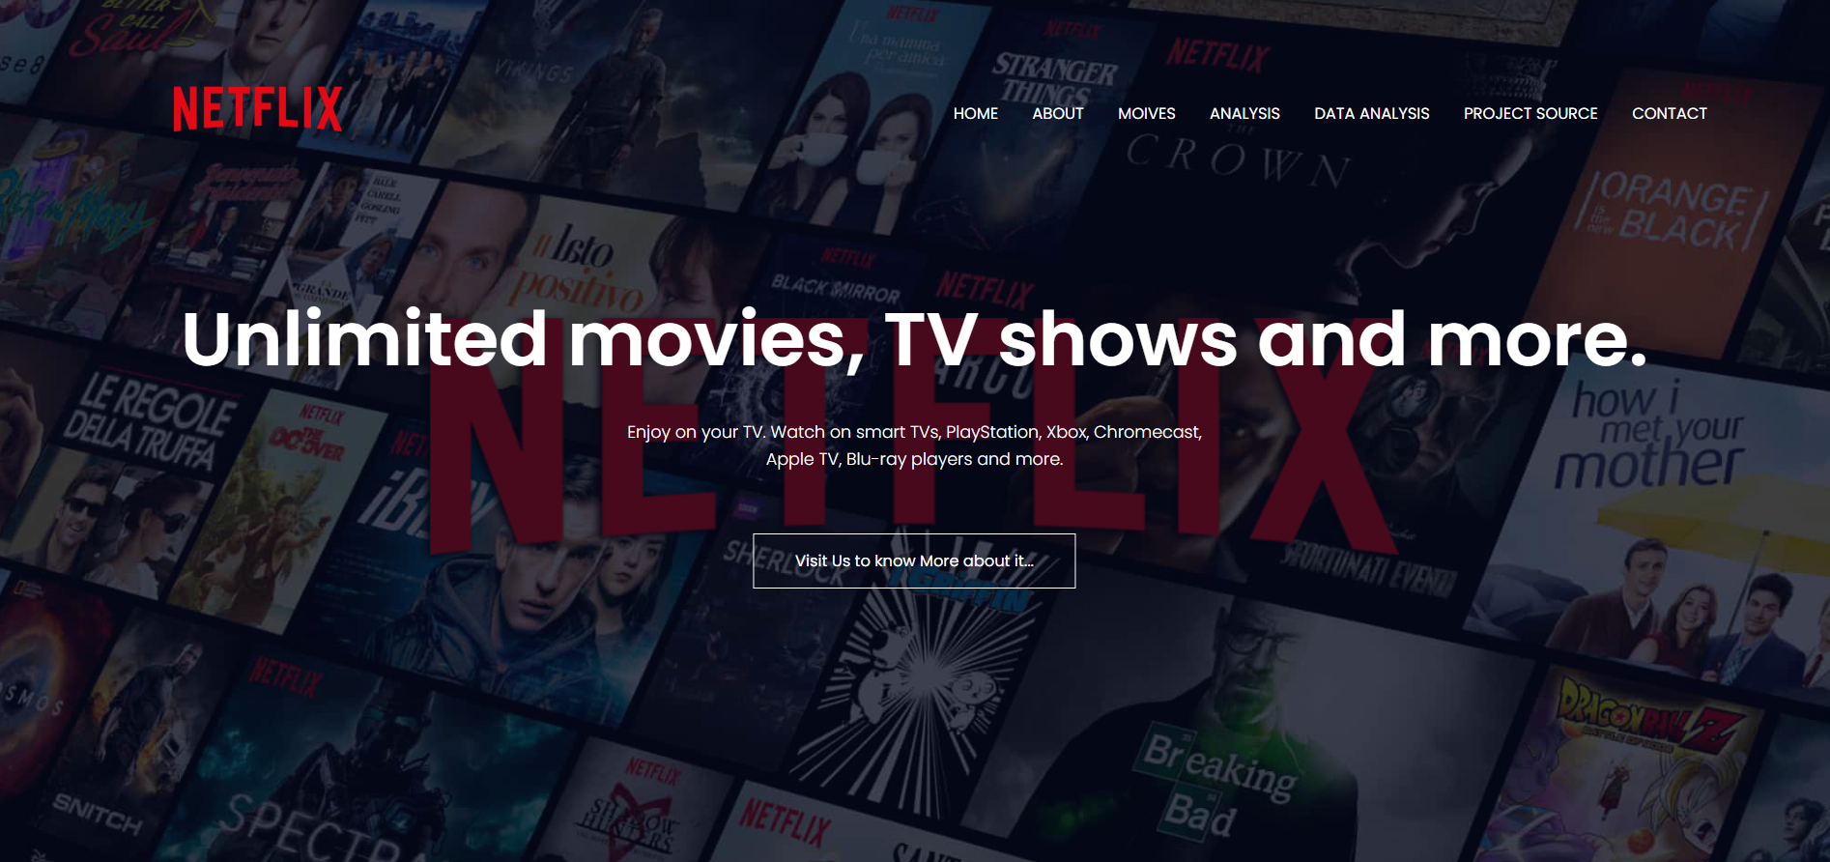
RESULTS

Slide 15
THANK YOU

